Slide 1
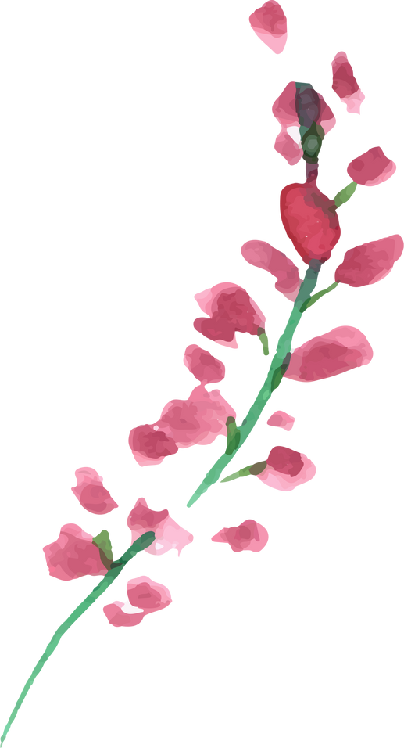
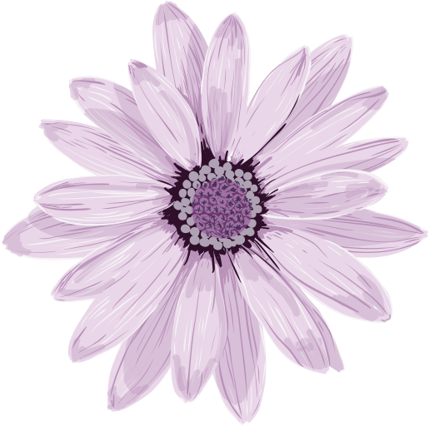
DIGITAL PORTFOLIO
STUDENT NAME:DHARSHINI.A
REGISTER NUMBER: 222406263
NMID NO:0421C1C13A5FBB6B8CF4A26B9E755FF1
DEPARTMENT:B.SC COMPUTER SCIENCE WiTH ARTIFICIAL INTELLIGENCE
COLLEGE:SRM ARTS AND SCIENCE COLLEGE
UNIVERSITY:MADRAS UNIVERSITY
Page
01

Slide 2


PROJECT TITlE
Front-End Techniques for Crafting
a Student Digital Portfolio

Slide 3



AGENDA
Problem statement
Project overview
End users
Tools and Technologies
Portfolio Design and Layout
Features and Functionality
Results and Screenshots
Conclusion
GitHub Link

Slide 4



Problem Statement
In today’s digital learning environment, students lack a unified, interactive platform to showcase their academic progress, skills, and achievements. Traditional paper-based or static portfolios fail to reflect the dynamic nature of student learning and digital competencies.

Slide 5


Project Overview
Our project involves designing and developing a responsive, user-friendly digital portfolio web application that allows students to present their academic work, projects, skills, and certifations in an organized and visually appealing way. The focus is on front-end technologies to ensure accessibility, interactivity, and modern UI/UX standards.

Slide 6


End Users
* **Students** (Primary users): To showcase their academic and extracurricular work.
* **Teachers/Mentors**: To review and provide feedback.
* **Recruiters**: To assess student profiles and capabilities.
* **Parents/Guardians**: To track student development and accomplishments.

Slide 7

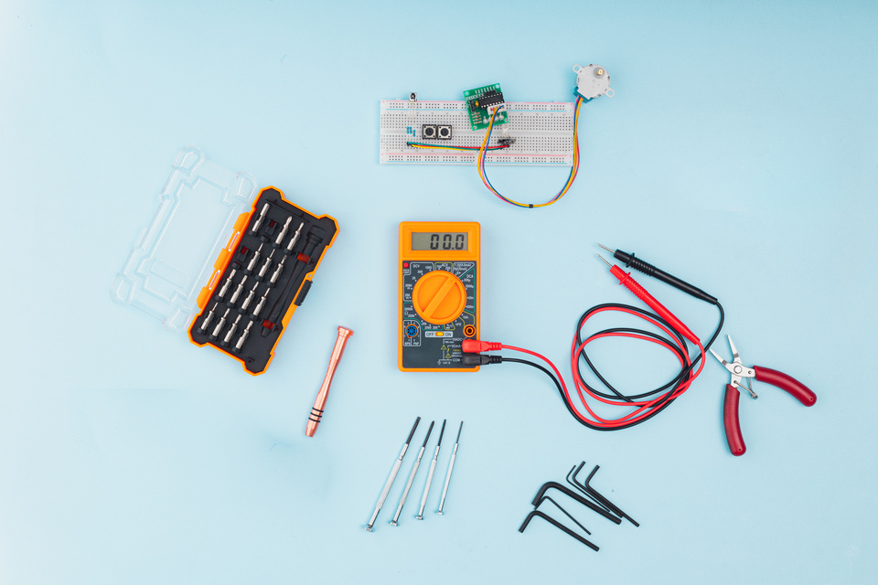
Tools and Technologies
* **HTML5, CSS3, JavaScript** – Core for structure, styling, and interactivity.
* **React.js** – For building reusable components and state management.
* **Bootstrap/Tailwind CSS** – For responsive design.
* **Figma** – For prototyping and UI design.
* **Git & GitHub** – For version control and code collaboration.
* **VS Code** – Primary code editor.

Slide 8
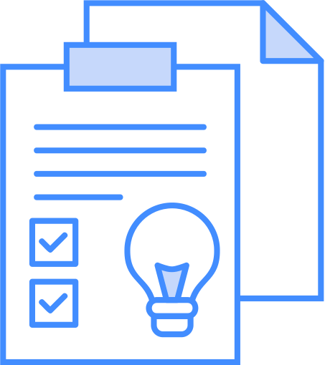


Portfolio Design and Layout
Homepage: Brief intro, photo, and quick access to resum
About Section: Background, education, interests.
Projects Section: Cards layout showcasing key projects with images, descriptions, and links.
Skills Section: Visual skill bars or icon-based skill representation.
Certificates Section: Upload and display certificates in an organized manner.
Contact Form: For feedback or recruiter connection.

Slide 9

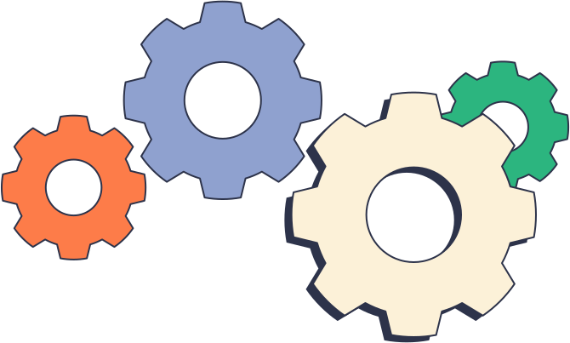
Features and Functionality
Fully **responsive** design for all devices.
* **Dynamic content rendering** using React components.
* **Dark/light mode** toggle.
* **Live preview** of uploaded projects.
* **Interactive forms** for contact and feedback.
* **Downloadable resume**.
* **Real-time updates** using JSON/REST API for data-driven content (optional).

Slide 10


Results and Screenshots
Showcase UI screenshots:
* Homepage
* Projects Grid
* Skills Progress Bars
* Responsive views (mobile/tablet)
* Performance metrics:
* Load time < 2s
* Mobile usability score: 95%+
* User feedback: Positive UI/UX from pilot users.

Slide 11



Conclusion
This front-end project not only helps students present their accomplishments professionally but also builds their digital literacy. The modern design and interactive features ensure that the portfolio is both functional and attractive to potential recruiters and educators.

Slide 12


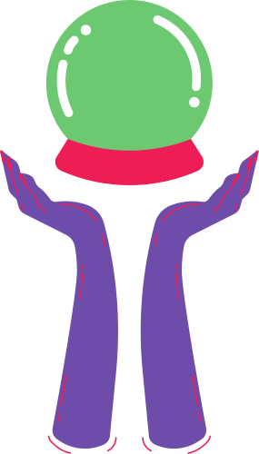
GitHub Link
https://github.com/dharshinia-ai/TNSDC-FWD-DP1-.git

Slide 13


